Slide 1
Restaurant Feasibility Study in the City of Perth, WA.
Applied Capstone Project.

Slide 2
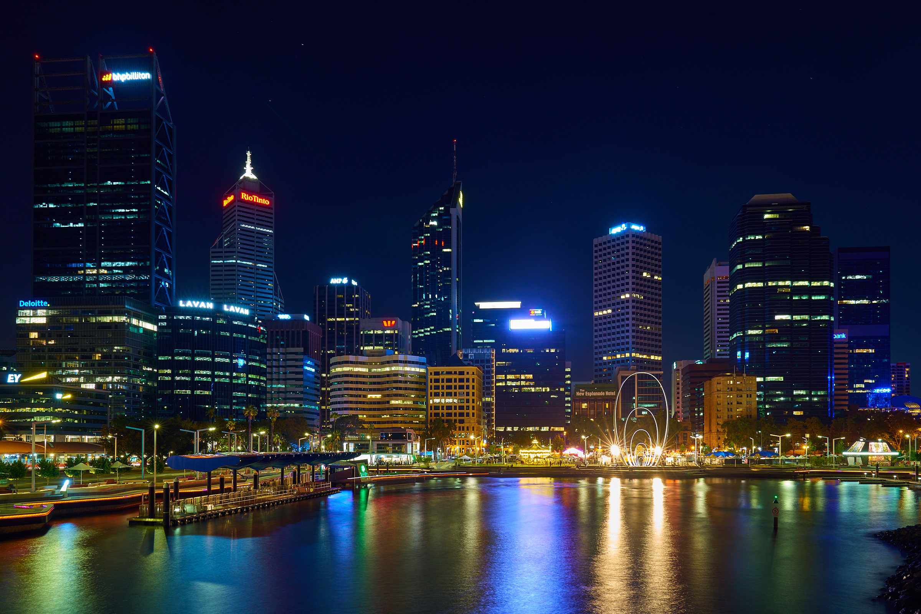

Slide 3
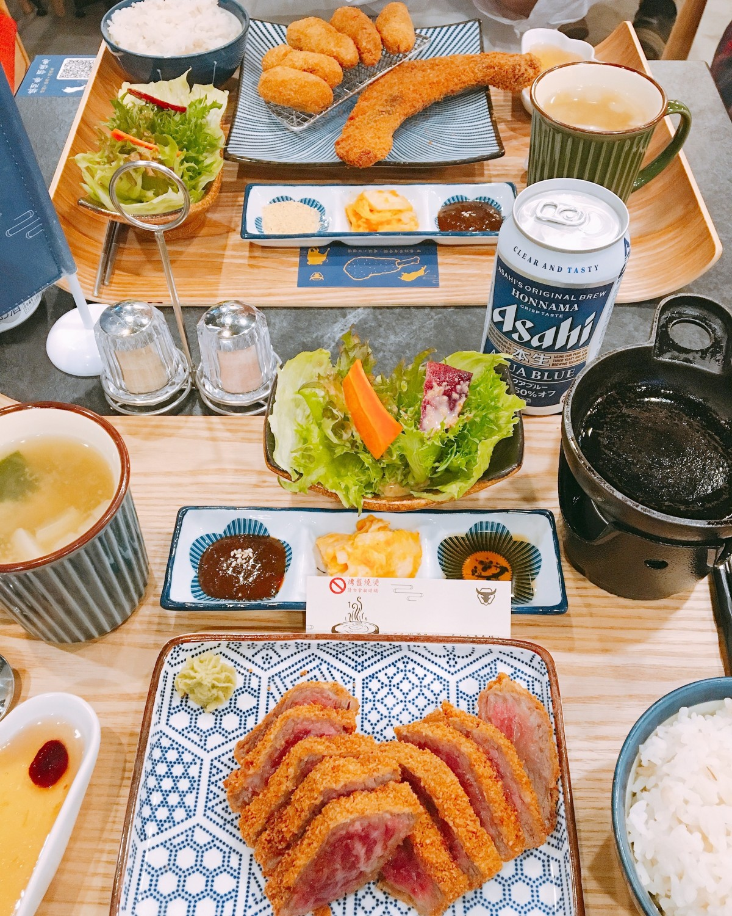
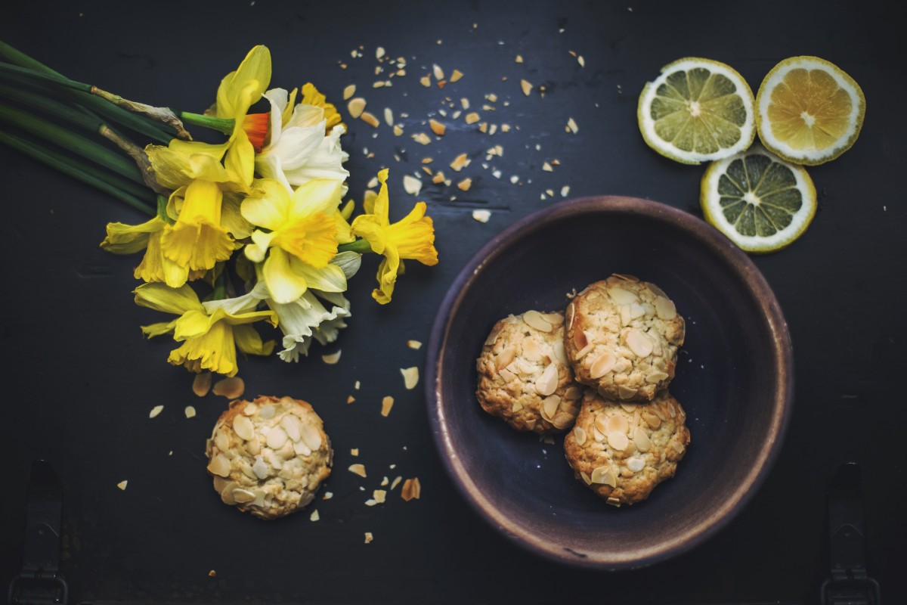
Food Opportunities in Perth.

Slide 4
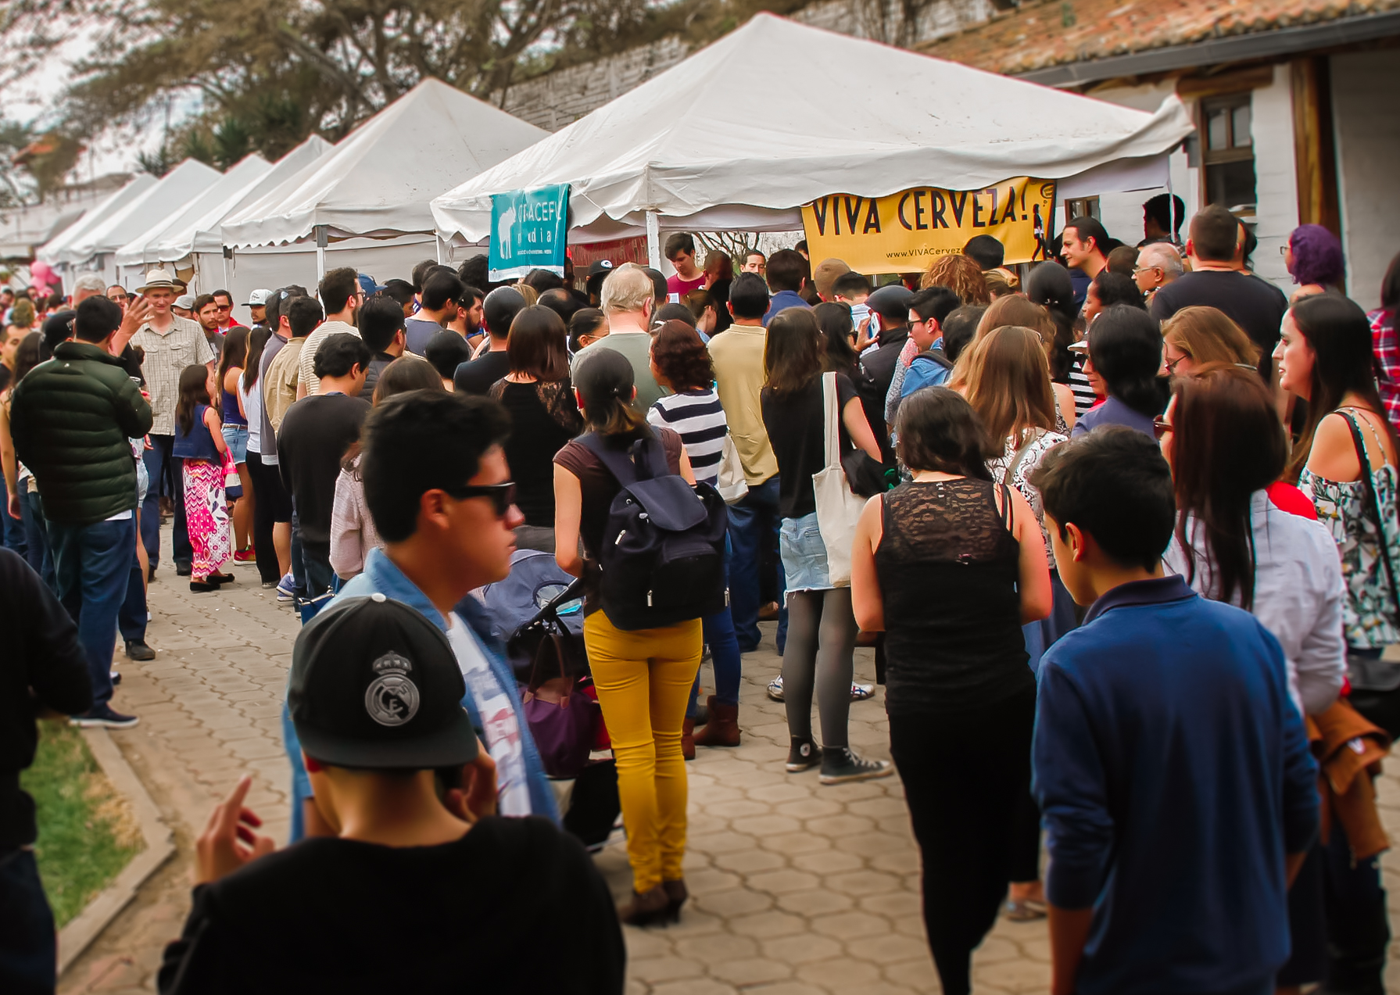
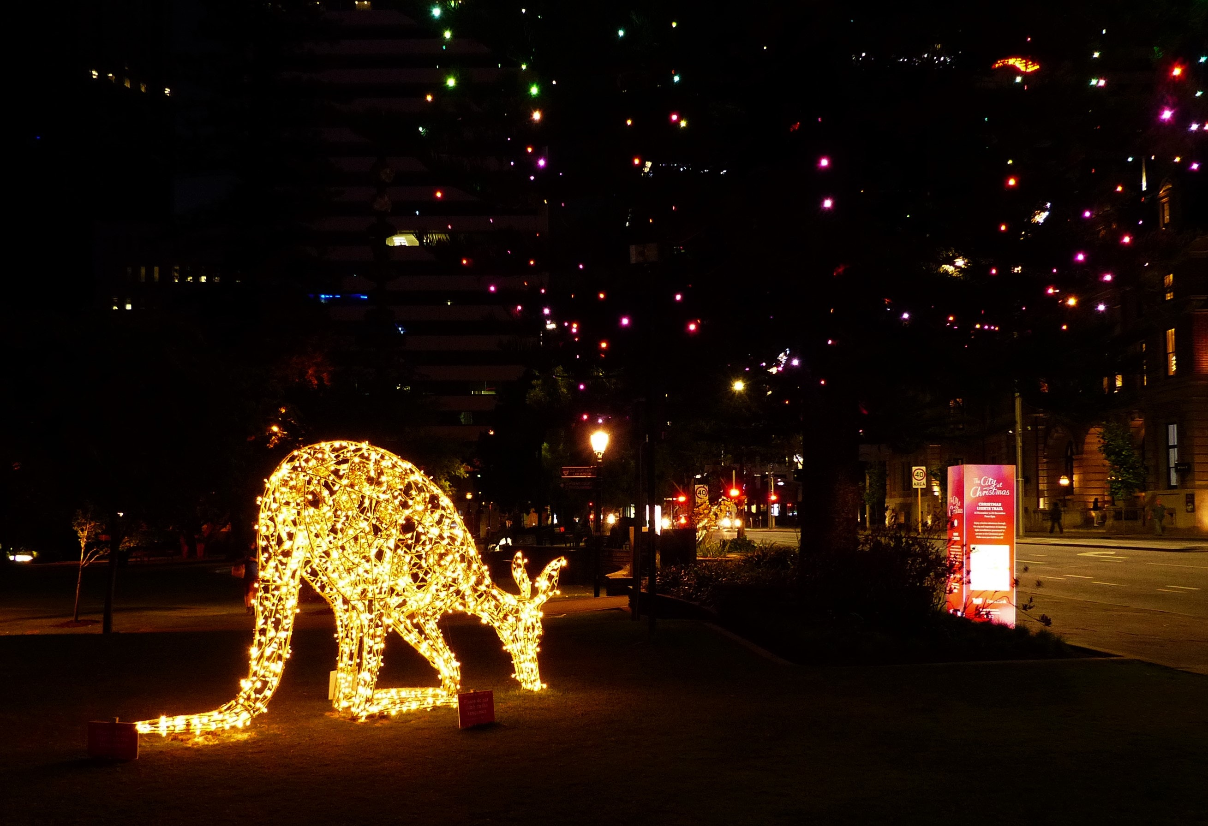
Introduction
City of Perth review for Investment Company.
Optimum location for new Restaurant business.
Business Problem:
Choice of location to start a Fast food business.
Need heavy footfall.
Low Advertising costs.
Choice of Cuisine.
Prominent Perth CBD Area.

Slide 5
Perth City – Business Environment
Market is open and there is plenty of room for expansion.
Developed city.
New business venture or expansion needs to be analysed carefully.
Cuisine availability in the city is a limited due to low population.
High Per Capita income ~$91,000.
Median age of 36 years

Slide 6
Perth City Cuisine
City of Perth is known for its high cost of living. Food not so much.
Italian, Asian and Indian Immigrants are the highest.
Pizza, Pad thai and Butter Chicken.
Chinese and other Asian restaurants, sandwich joints plenty.
With a variety of foods present its imperative for us to find a good cuisine which is not as readily available but has a good name.

Slide 7
Factors to decide on restaurants location
Are there any venues like Food Courts, Car Parks, Parks, Bus Zone etc nearby where floating population is high etc
Who are the competitors in that location?.
Cuisine served / Menu of the competitors.
Existing high foot fall areas to save on Marketing.
The list can go on...

Slide 8
Data Description
Perth city geographical coordinates data will be utilized as input for the Foursquare API. We will use the Foursquare API to explore neighbourhoods in Perth CBD. The below is image of the Foursquare API data.

Slide 9
Methodology -1
Perth City CUISINE : Most Preferred Food in Perth CBD –Italian, Thai, Vietnam, Asian, Indian, KFC & Burger Joint.
Perth city geographical coordinates data has be utilized as input for the Foursquare API, that has been leveraged to provision venues information for each neighbourhood.
We used the Foursquare API data to explore cuisine in Perth CBD.
Using the geographical coordinates of each neighbourhood FourSquare API calls are made to get top 100 venues in a radius of 1000 meters.

Slide 10
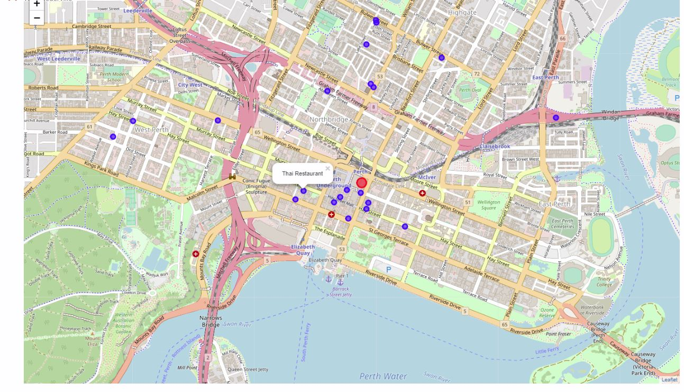
Methodology -2
Maps and tables of Thai Restaurant.

Slide 11
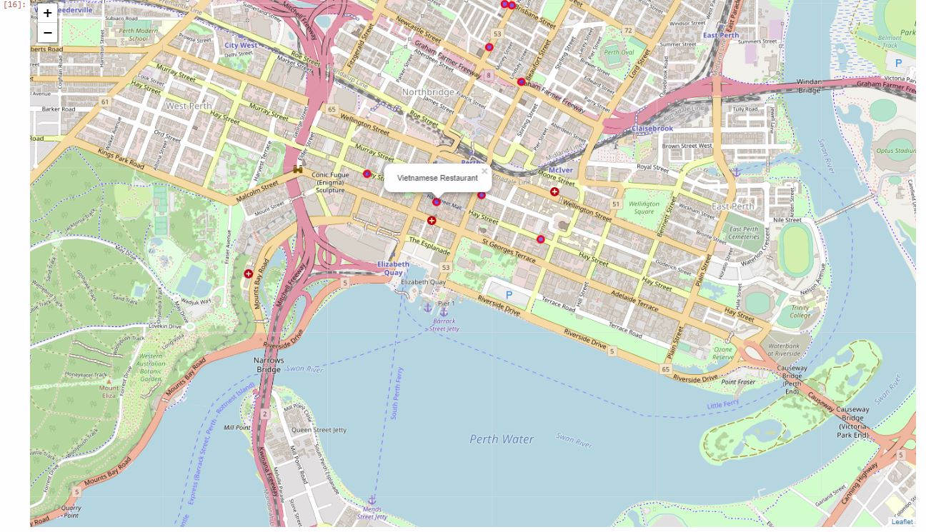
Methodology -3
Maps and tables Vietnamese Restaurant .

Slide 12
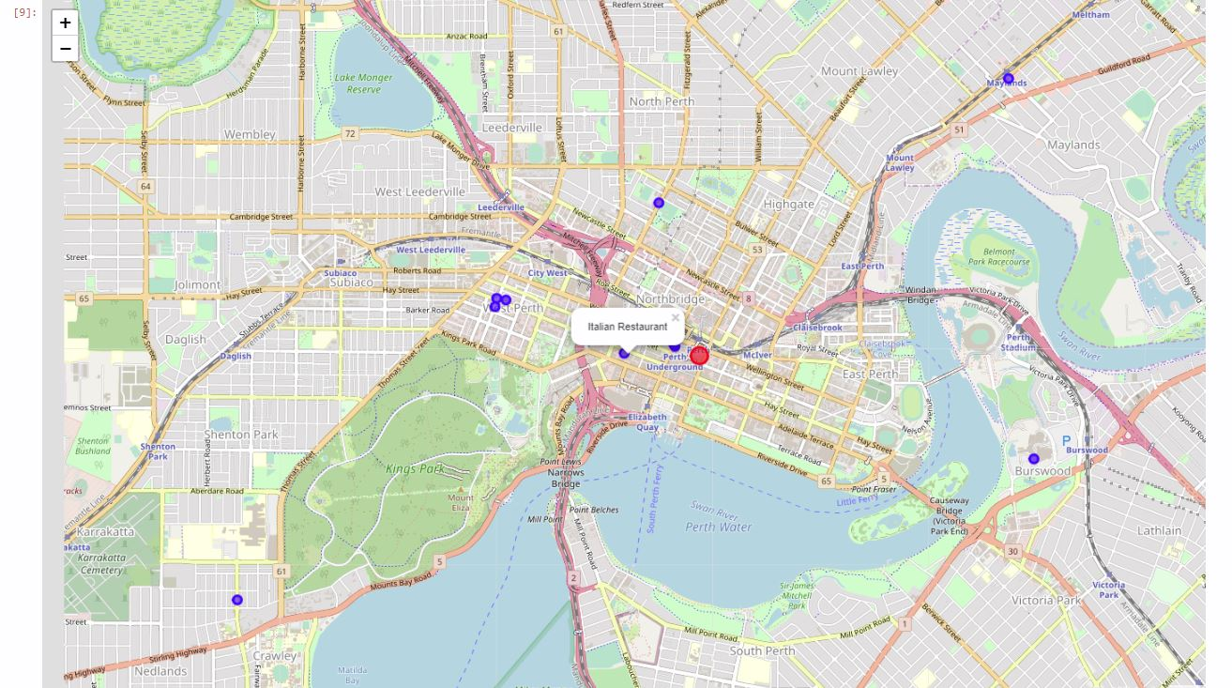
Methodology -4
Maps and tables Italian Restaurant .

Slide 13
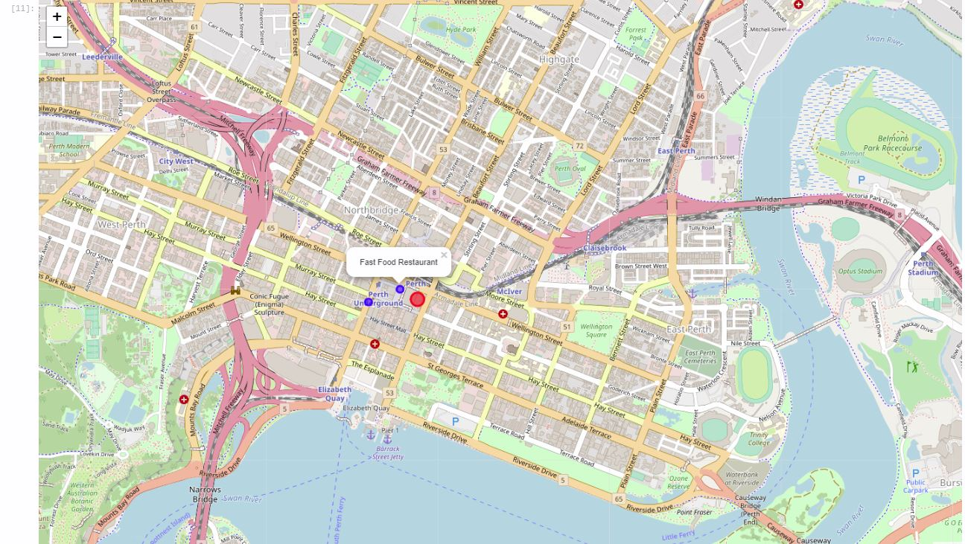
Methodology -5
Maps and tables KFC Restaurant .

Slide 14
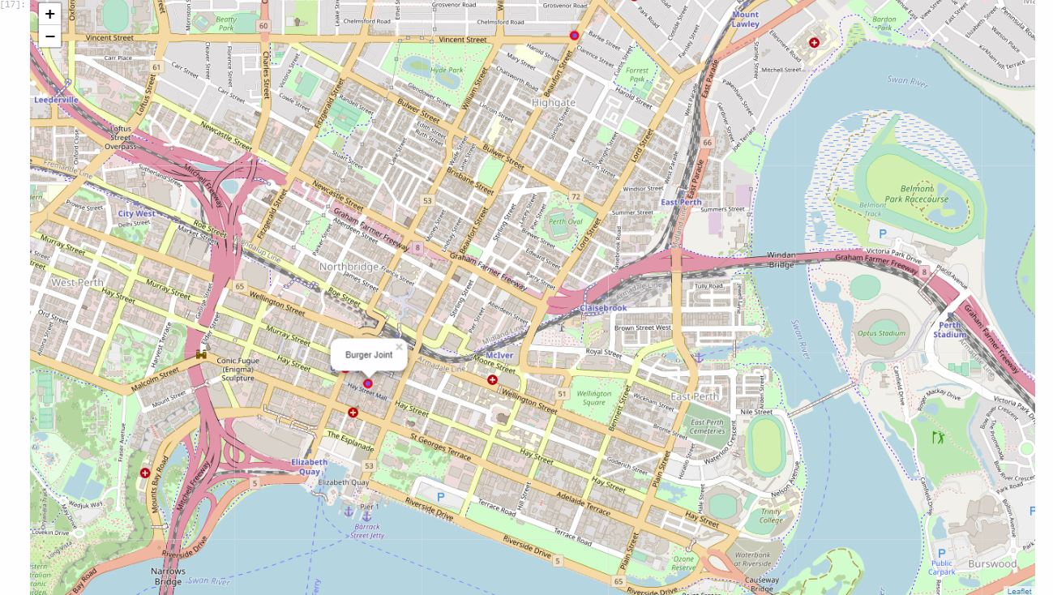
Methodology -6
Maps and tables Hungry Jacks Restaurant.

Slide 15
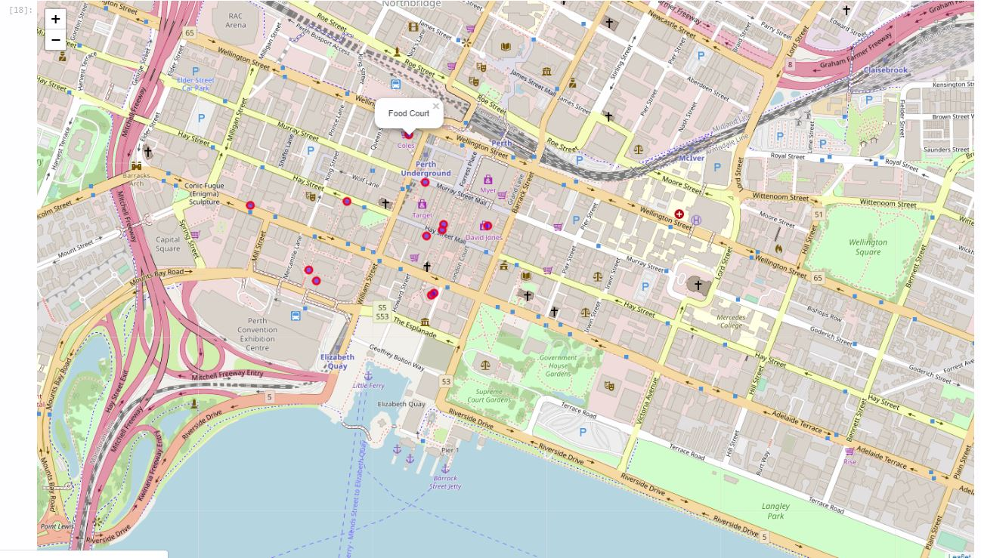
Methodology -7
Maps and tables Food Courts Restaurant .

Slide 16
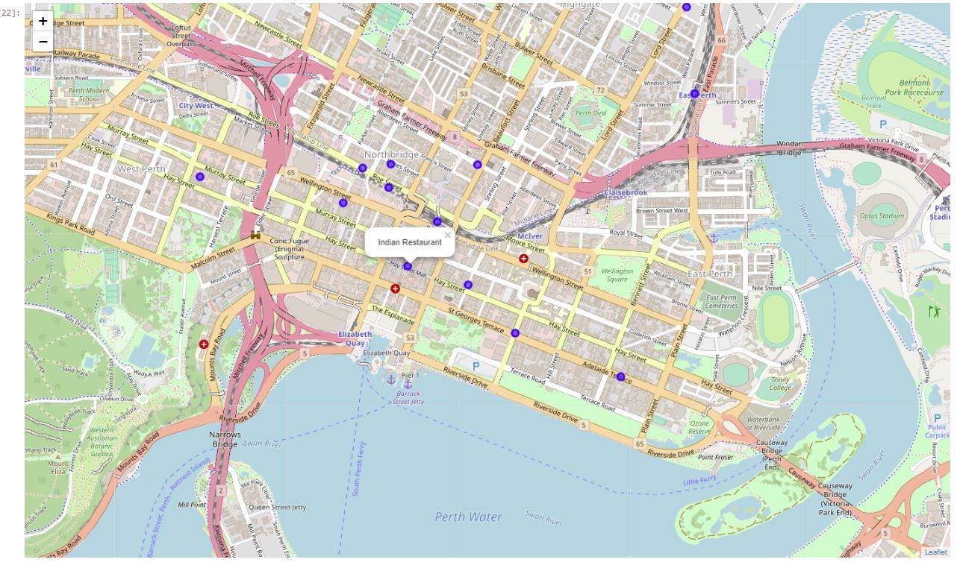
Methodology -8
Maps and tables Indian Restaurant.

Slide 17
Discussion
1. There is scope for opening of a Mexican restaurant in Perth CBD.
2. The Cuisine is not adequately present in the city.
3. Mexican food through out the world has a reputation for being very spicy, but it has a wide range of flavours.
4. It is a cheap and good option to open one is Exnex 100 Foodcourt in the City of Perth.

Slide 18
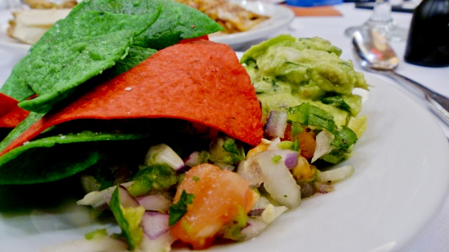
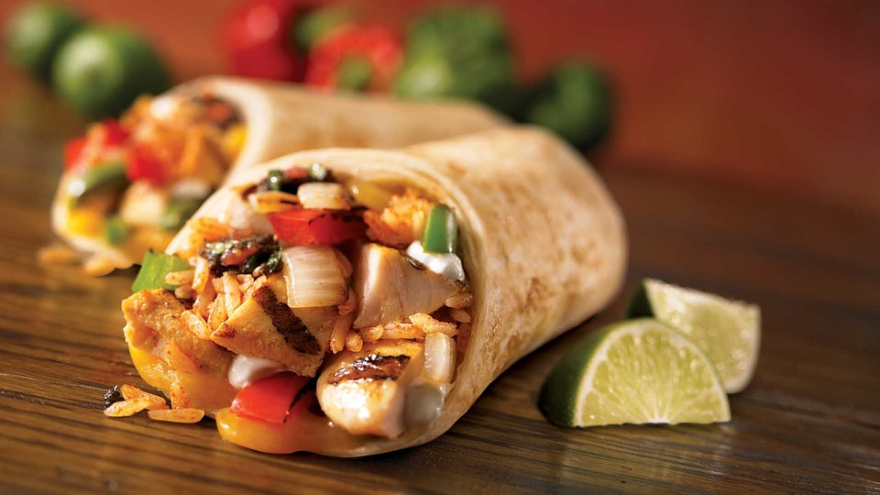
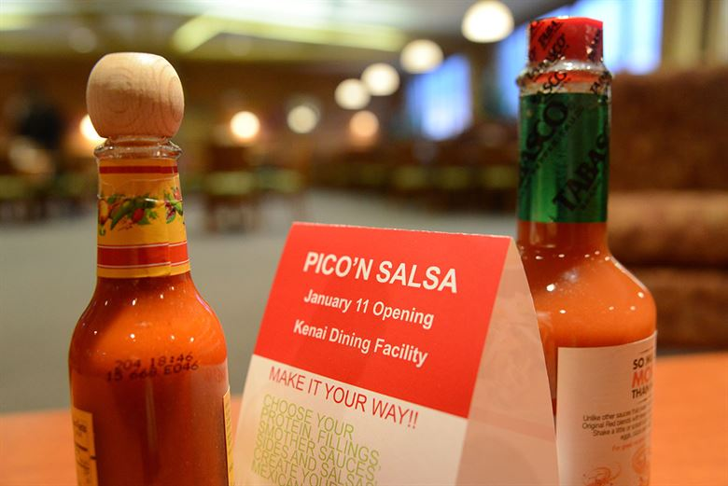
Result
As there is an upcoming trend of Mexican cuisine coming up we would like to recommend a Mexican Restaurant. A Low risk and a competition is identified with it.

Slide 19
Conclusion

